Slide 1
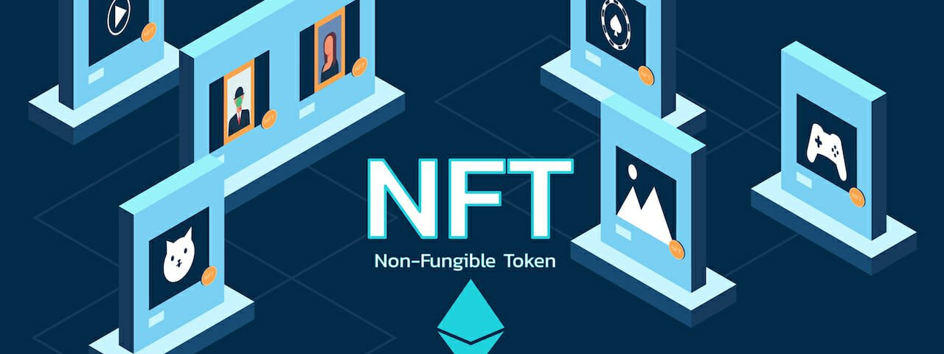
NFT Price Tracker
Contributors: Chantal Garnett, Sameer Lakhe, Emiliano Mendez, Marcus Policicchio,
University of Toronto FinTech Boot-Camp: Project 1 - April 18, 2022

Slide 2
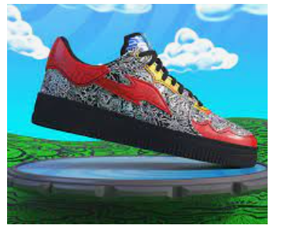

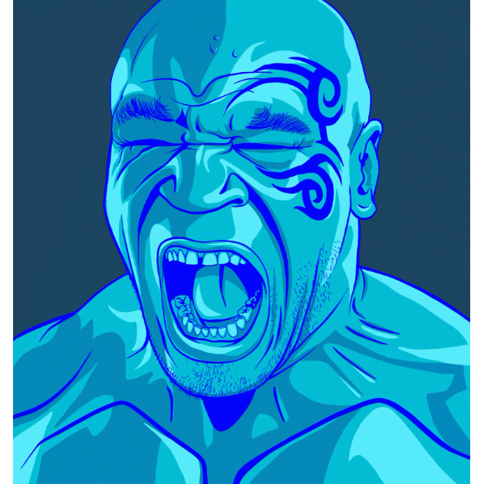
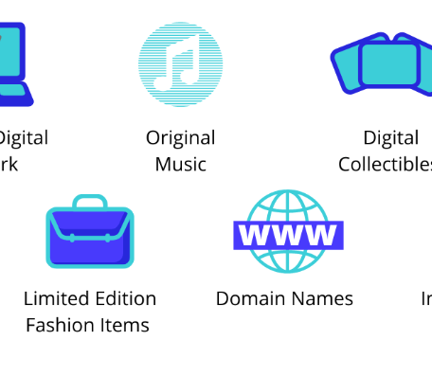
What is an NFT?
A digital asset that is unique and represents real-world tangible objects like art, music, in-game items, videos, audio recording and photos.
Bought and sold online, with cryptocurrency on specialized market-places like OpenSea.
Exchanged in the Ethereum (ETH) blockchain.
A digital certificate of authenticity.

Slide 3
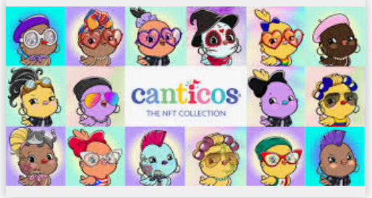
Background and Motivation NFTs Represent an emerging growth ecosystem.
NFTs have skyrocketed over the last year.
NFTs are important elements of the Metaverse.
NFTs are
retail-driven
3,200 active collections in OpenSea at the end of 2021
193 at the beginning of March 2020
It is estimated that bringing the Metaverse to life may represent $1 Trillion USD in annual revenues
It is expected that Gen Z will be the main driver of early adoption of Web 3.0/Metaverse.
It is quite concentrated with the top 95 collections representing half of all NFT flips on OpenSea.

Slide 4
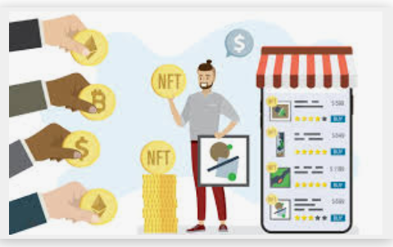
Meet our typical user, John: A young professional who has $10 000 CAD to invest in the new emerging volatile market of NFTs. However, John knows very little about NFTs and even less about where to begin.
The NFT Price Tracker
The NFT Price Tracker will:
Track and predict future NFT prices for 30 days based on average prices for 5 popular NFT collections over 6-months.
Calculate the amount of ETH needed to purchase a particular NFT collection.
Compare and forecast NFT valuations.
Show the total number of sales for each collection.
Identify top NFT projects based on popularity and activity, to help investors and traders decide which collections to purchase based on their risk tolerance.
There is a need for:
An interactive platform designed for the novice investor, trader or collector to understand the NFT market.
Providing information on trends, sales, recommendations on when, how and if to purchase or sell new and established collections.

Slide 5

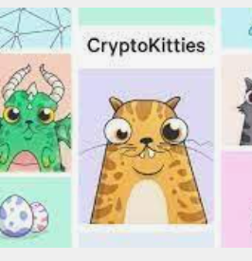
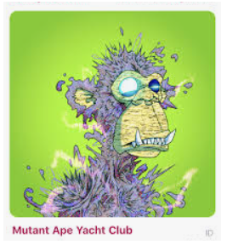
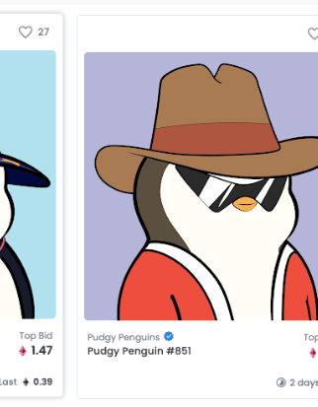
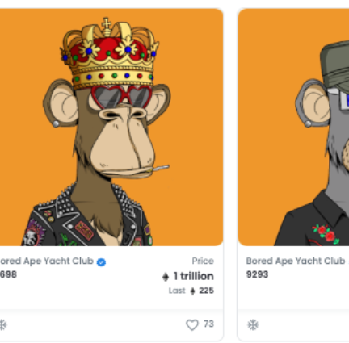
Collections used were based on available data and selected from the top 25 most popular NFTs.

Slide 6
Key Questions
Question | Data source | Tool used
Which NFT collections offer the best risk / reward ratio? | OpenSea API Alpaca API | APIs Python Monte Carlo simulation
How can we predict the future price of an NFT collection? | NFT floor prices pulled from various top collections using the collection ‘slug’. Data sourced from OpenSea API. | APIs Python Monte Carlo simulation
How can we visually compare price performance of various NFT collections? | OpenSea API | APIs Python PyViz for visualization IPython.display Streamlit

Slide 7
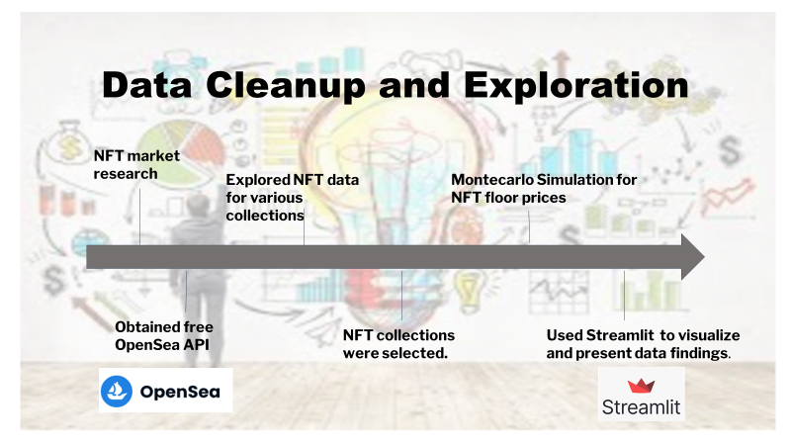
CHALLENGES | MITIGANTS
A Metamask wallet with non-zero Eth balance was required. Accessing the data from OpenSea | Submitted three different API requests to OpenSea early in the process to minimize risk of not receiving the key. Ensured an active metamask wallet with Eth was available.
Insufficient data from some NFT collections | Collections within the top 25 most popular NFTs with the longest price history available were used.
Some collections have significant price volatility which impacts the Monte Carlo Simulations | Manual adjustments and data cleanup were required. Used average daily price to show trends over time. Used rolling median to show Monte Carlo Simulations
Making the data accessible to the end user | Stremlit to display charts and data in a user friendly and interactive manner.

Slide 8


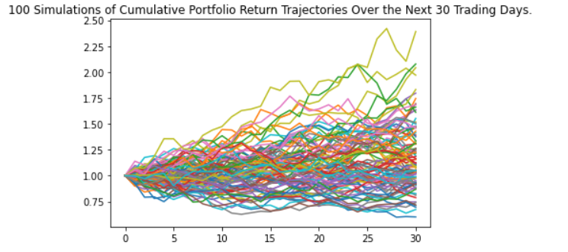
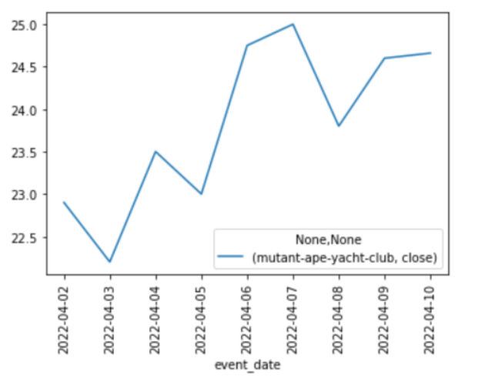
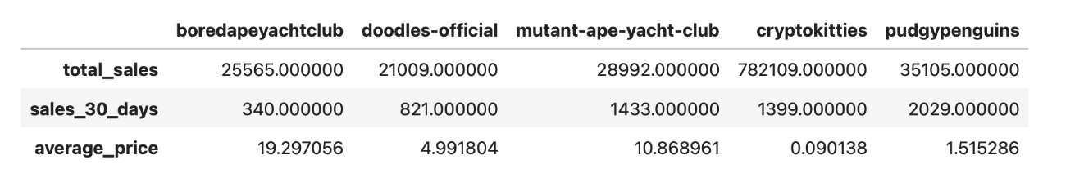
Data Analysis and Key Findings
Mutant Ape Yacht Club
Recommendations for our user John:
John can purchase 2.63 ETH with $10 000 CAD
Based on average price of NFT assets, he can purchase:
cryptokitties (0.090138 ETH)
pudgypenguins (1.515286 ETH)
If John has a high risk tolerance, then cryptokitties would be a better investment because it has a higher price potential but also greater risk for loss of investment.
MonteCarlo simulation:
Predict with 95% accuracy the lower and upper bounds over 30 days.
Average daily price over 6 months for each of the 5 NFT collections.
Total Sales for each of the 5 collections.

Slide 9


Next steps:
Project 2 :
Host the notebook on AWS cloud.
Compare different NFT collections: User will be able to input a specific collection and/or select from a list to obtain statistics.
More collections and visualizations will be added to the tracker.
Ask user for risk tolerance and provide output based on sharpe ratio.
Provide steps to purchasing an NFT.
Project 3:
Social media analysis – (ie. twitter for NFT projects to get sentiment analysis).
Check for explosive growth and categorize them with potential profitability.
Alerts-identify dips and recommend buy/sell.
Alerts: Indicator of when prices increase or decrease.
Explore addition of NFT rarities into the model.
Create an NFT.
Tracker will be offered as part of an incentive to purchasing an NFT.

Slide 10

Questions:

